Slide 1

Vivekanand Education Society’s Institute Of Technology
Department Of Information Technology
DSA mini Project
A.Y. 2025-26
Sustainability Goal :
Title:
Domain: Data structure & algorithms
Member: Vinay motwani
Mentor Name: Kajal jewani

Slide 2


Slide 3
Content
Introduction to the Project
Problem Statement
Objectives of the Project
Scope of the Project
Requirements of the System (Hardware, Software)
ER Diagram of the Proposed System
Data Structure & Concepts Used
Algorithm Explanation
Time and Space Complexity
Front End
Implementation
Gantt Chart
13. Test Cases
14.Challenges and Solutions
15. Future Scope
16. Code
17. Output Screenshots
18. Conclusion
19. References (in IEEE Format)

Slide 4
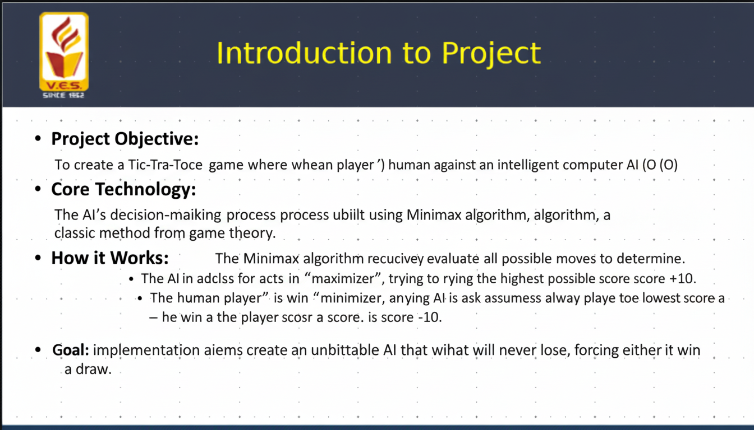
Introduction to Project
r Rates

Slide 5
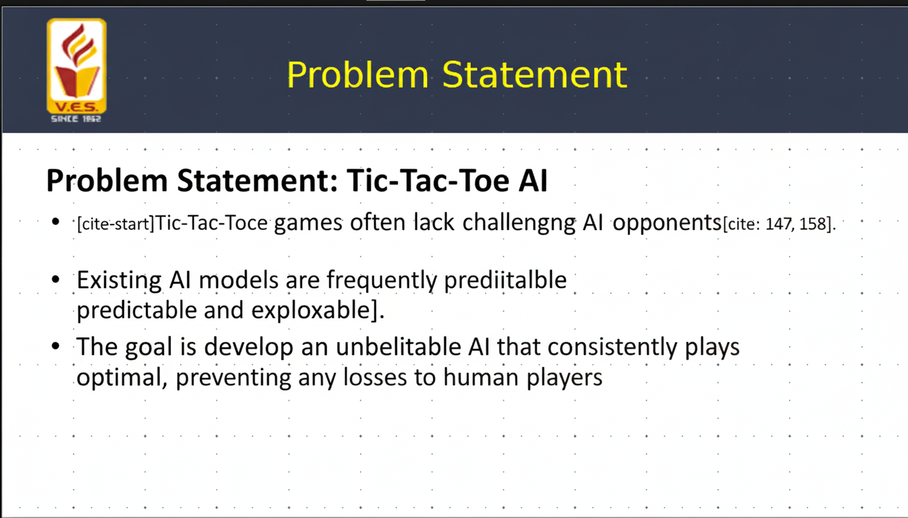
Problem Statement
r Rates

Slide 6
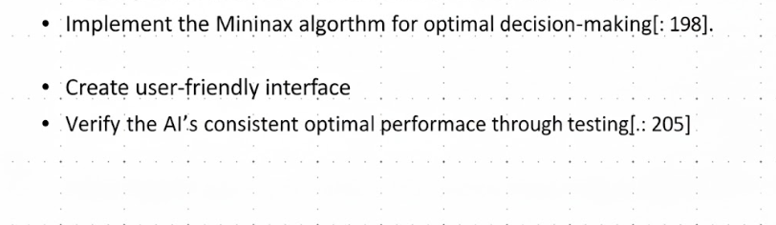
Objectives of the project
Develop an AI that is unbeatable in Tic-Tac-Toe[cite: 178].
r Rates

Slide 7
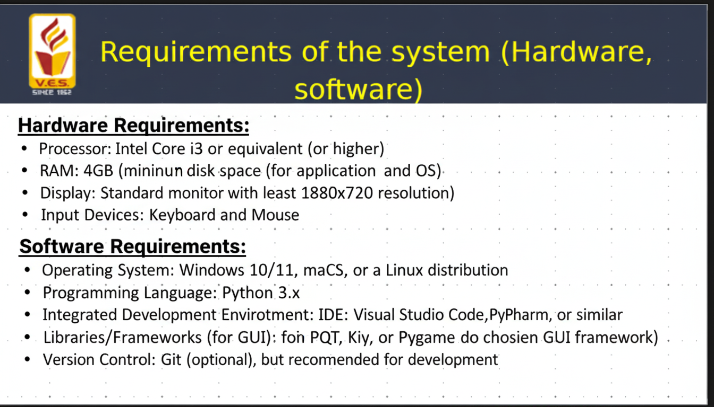
Requirements of the system (Hardware, software)
lem Statement
Problem Statement

Slide 8
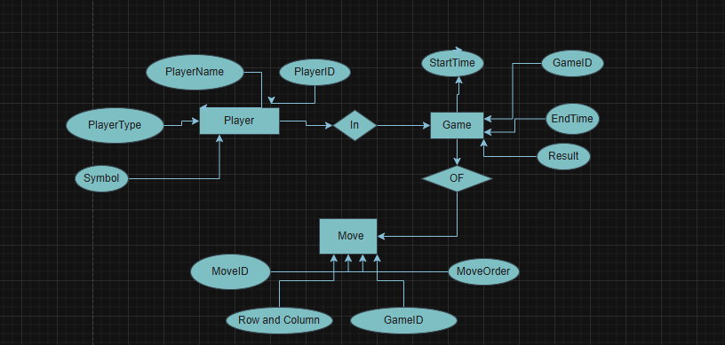
ER diagram of the proposed system

Slide 9
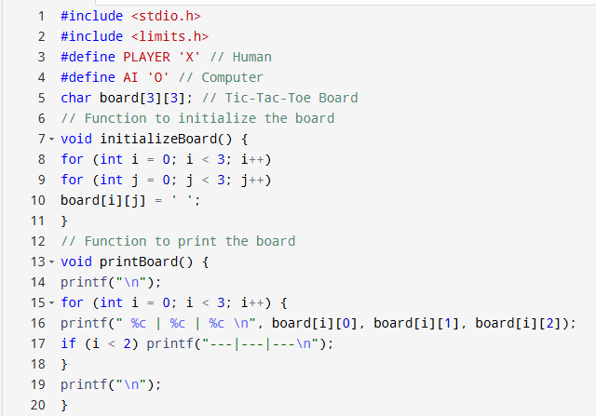
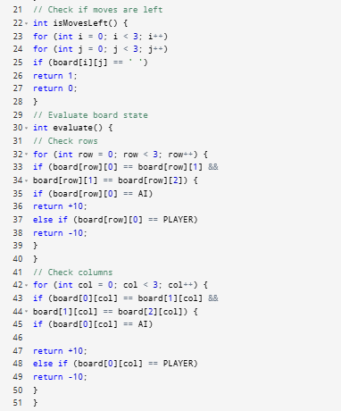
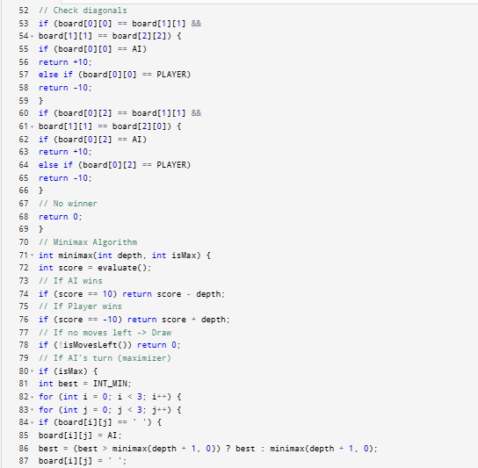
Front End

Slide 10
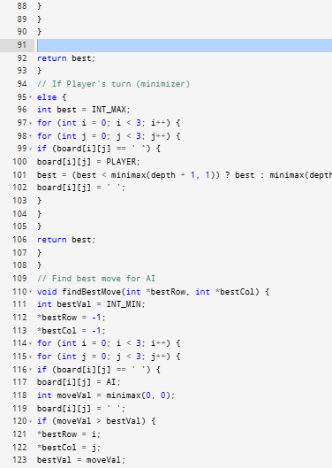
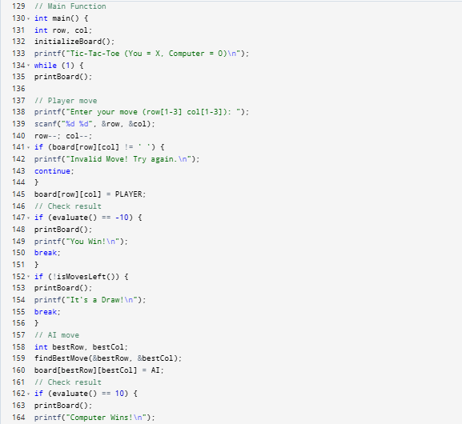
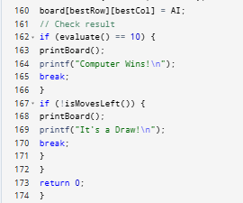

Slide 11
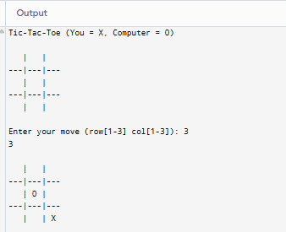
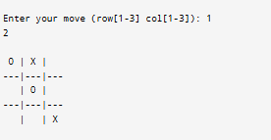
Implementation

Slide 12
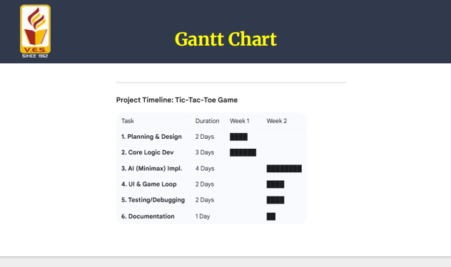
Gantt Chart
Notes:
The max flow algorithm in the visualization is :-

Slide 13
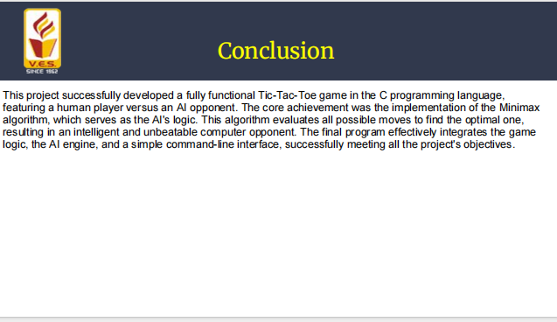
Conclusion

Slide 14
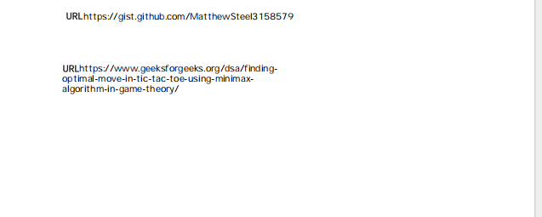
References

